Slide 1
Measures to prevent covid-19
March 2020

Slide 2
Identifying Prevention Methods
To ensure continuous alignment with government regulations:
The Health and Safety at Work Act 1974 Section 2(1)
The Health and Safety at Work Act 1974 Section 7
CTD will indicate to staff that preventative measures and methods are in place to ensure the occupational health, safety and wellbeing whilst operating on site during the coronavirus COVID-19 outbreak.
All posters relating to these prevention methods to display the Coronavirus prevention symbol.
This can be edited for any site
CORONAVIRUS
PREVENTION

Slide 3
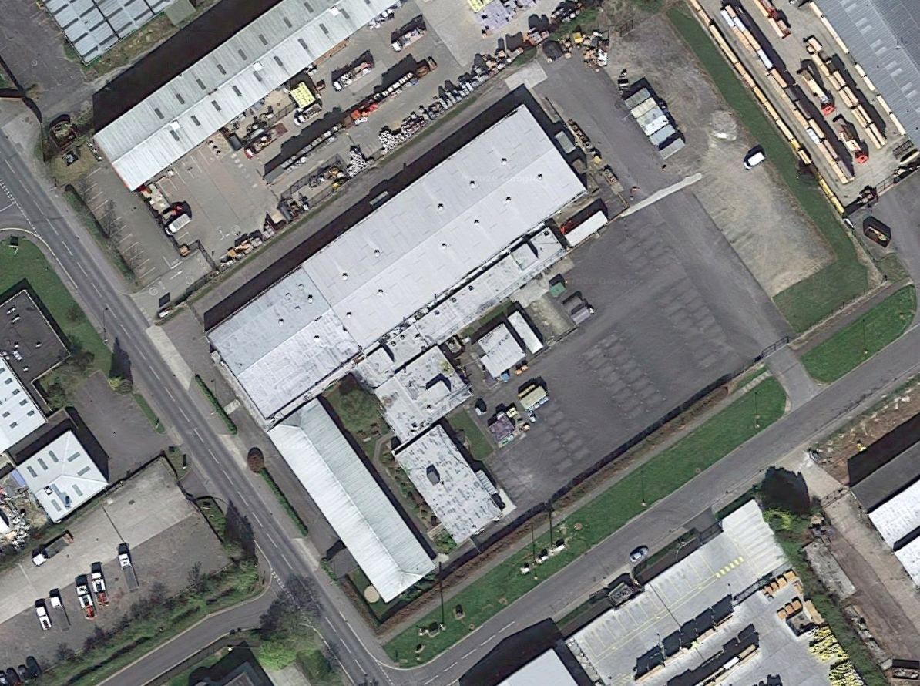
Entrance for staff onto site
Entrance into the building is restricted to
The double green doors by the main car park
Restricted access to
Side Gate
OFFICE STAFF ONLY AFTER SIGN IN AT MAIN ENTRANCE AND MANAGEMENT AWARE
Main entrance
No access from
Reception
Side Entrance
We need to reduce the number of “Touch Points” by reducing access
No access

Slide 4
Social distancing
In any opportunity where there is a queue, the staff are instructed to keep a minimum distance of 2 meter from each other. This includes the canteen facility, entering the building or getting their temperatures checked.
It situations where seating is used, staff are reminded to ensure that a minimum 2 meter distance is enforced.
Breaks and meal periods have their time staggered to reduce the opportunity for overcrowding.
Where possible staff are instructed to reduce face to face meeting and instead use online methods for meetings or send an email with all the relevant details.
OK
NOK
2M
2M
☺
OK
NOK
2M
1M
0.5M
Queue example
Seating example
2M
2M

Slide 5
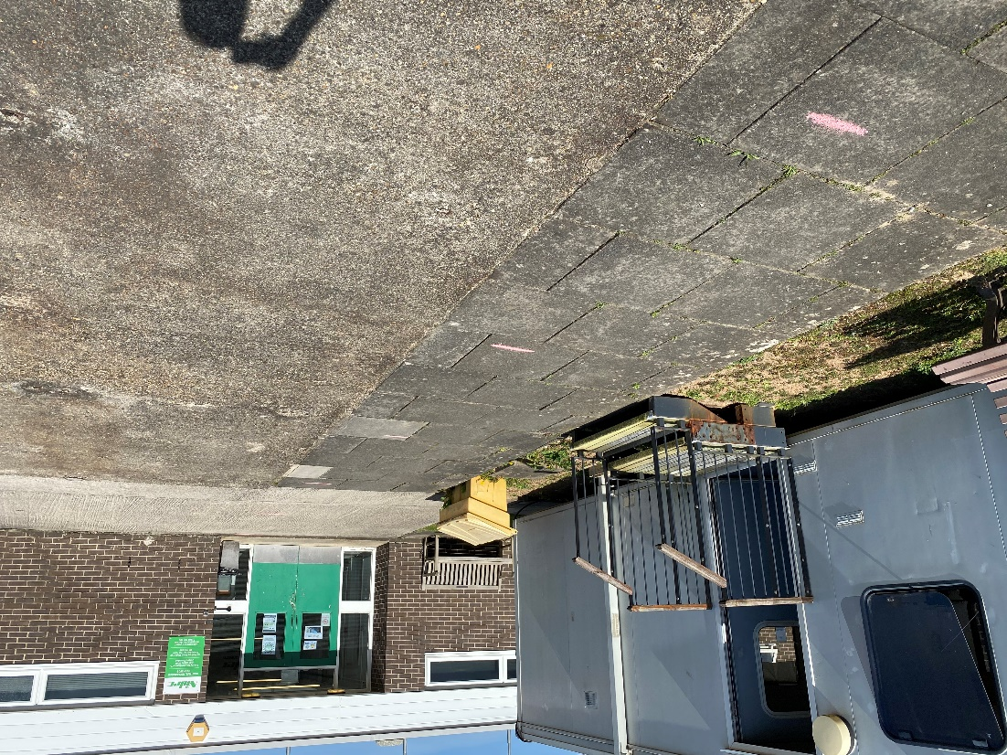
Queueing for the factory
It may take some time for everyone to enter the building with the distance precautions in placed
During this time we ask that if there is a long queue or the weather is unappropriated for standing in, then all staff to wait in their cars (or under cover in poor weather conditions) until access to building is clear in order to keep queue length to a minimum
Car Parking
Locations
2 Meter spaces marked on the main entrance floor

Slide 6
Restricted Areas
FULL RESTRICTION
These areas have been designated restricted and should not be used.
With locker rooms you may pass through them towards the toilets but do not use the locker room for storage
PARTIAL RESTRICTION
These areas are restricted to those with relevant access and appointed First Aid persons
ENTRANCE
NORMAL ACCESS
No one allowed in the office unless agreed by Paul Watson
Access for normal use

Slide 7
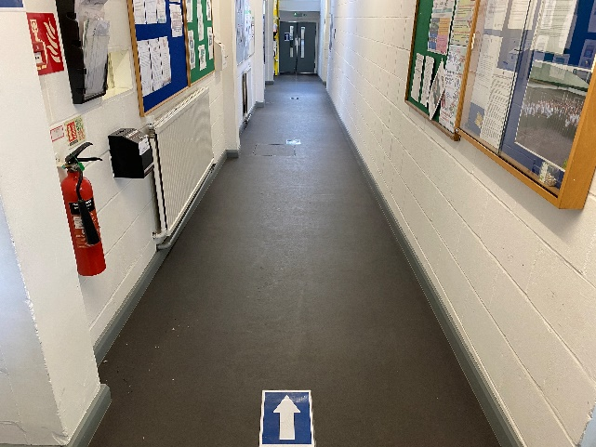
One way system for main corridor
The main access corridor through the factory must now use a one way system. This is shown with the green arrows
This is to reduce the opportunity to cross paths with another person who may also use the corridor in the opposite direction.
To facilitate this staff must use both the canteen and the production floor for travel.

Slide 8
Total Employee Protection Measures
Safety Glasses
Face Mask
Safety Shoes
Nitrile Gloves
Standard PPE
Extra PPE

Slide 9
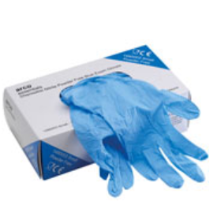
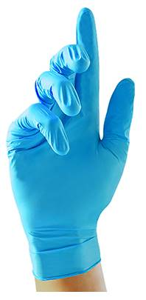
Gloves
Staff are instructed that whilst on site, they are to wear nitrile gloves.
This is to mitigate any opportunity for the staff to come into contact with either surfaces treated with disinfectant spray (In case of allergic reaction) or for the surfaces that have yet to be disinfected.
This measure is to remain in place whilst the UK is on its upward trend of coronavirus cases
Although there have been no guidelines stating that they will help protect the individual, these measures should help reduce the opportunity for transporting the virus onto multiple surfaces and to reduce the amount of times the staff member touches their face.
Whenever gloves are removed, THEY MUST BE REPLACED WITH NEW
Where possible, gloves are to comply with technical standards:
EN ISO 374-1:2016/type C K
EN ISO 374-5:2016 Virus
EN 1186

Slide 10
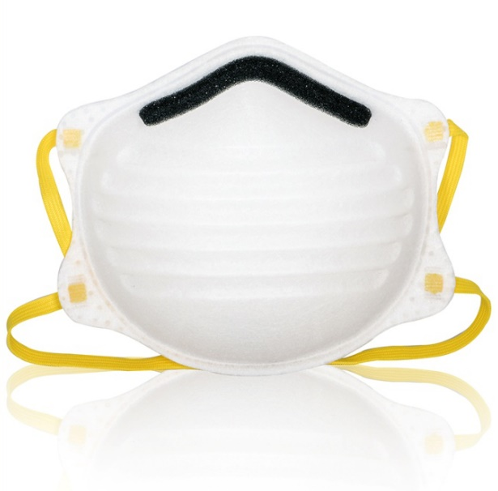
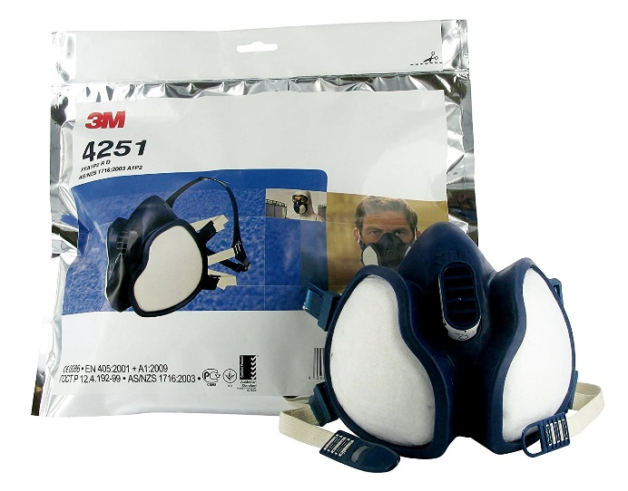
Masks
All employees are instructed to wear a facial mask whilst on site (Masks can be reused for up to 3 days)
The exposure limit of the virus means that staff can wear the masks for 1 week before discarding
Masks must be worn when entering and exiting the building
All masks are manufactured in accordance with BS EN 149:2001+A1:2009
These masks to be rated above FFP2 where possible (FFP3 preferred for maximum protection)
This is equivalent to N95 (USA) or KN95 (China)
Procurement to continuously source masks to maintain safety stock of 2 weeks
Masks to remain in quarantine for 72 hours before issue to staff

Slide 11
Mask Free Areas
INSIDE THE BUILDING
For the safety of all employees the guidelines state that when inside the building you must wear a mask
MASK FREE AREA
It is uncomfortable to wear a mask for extended periods
The green areas have been designated for wearing no mask.
You must keep the 2 meter rule whilst in these areas
All outside areas

Slide 12
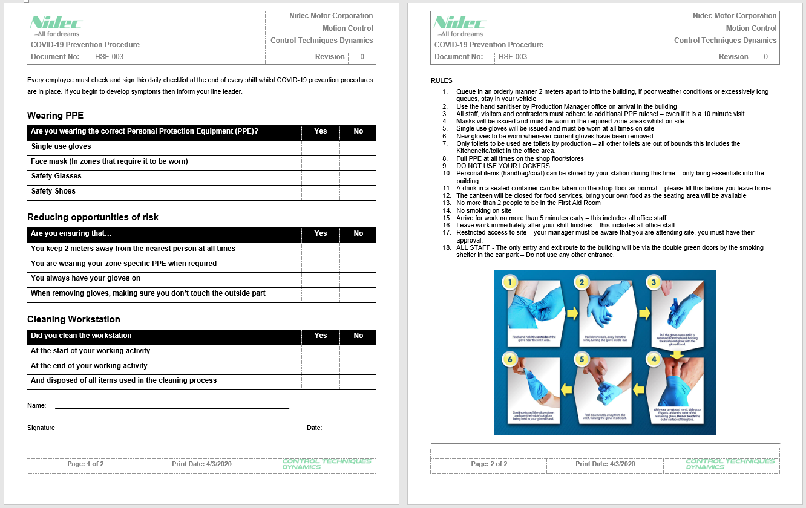
Daily Operator Checklist
This Daily Checklist is printed and completed by each employee on every shift before leaving site.
This document is printed so that only 1 sheet of paper is used
The rules for the site whist under the Coronavirus Prevention Policy are display on the back of the document
Steps required to be taken are confirmed that they have been completed by each person checking either “Yes” or “No”
Instruction for safe removal of gloves is also included

Slide 13
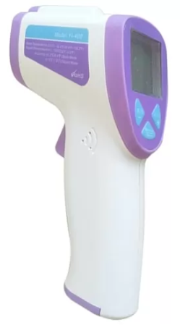
Body Temperature examination
Upon entry into the building, staff will be required to use the hand sanitiser
All persons that come onto site need to have their body temperature taken, the results should be around 37℃ (Body temperature fluctuates at +/- 0.5℃)
1st Shift Temperatures checked by: RUSSELL STEWART / PAUL AYLING
2nd Shift Temperatures checked by: GEORGE STOCKDALE
Any result over 37.8℃ will not be allowed to proceed any further into the building
Staff will also be asked to self assess their health condition, if the staff member feels unwell they will need to make a judgement on if they feel they are fit to work, if not they should stay home
Normal is around
Greater than or equal to
37℃
37.8℃
OK
NOK

Slide 14
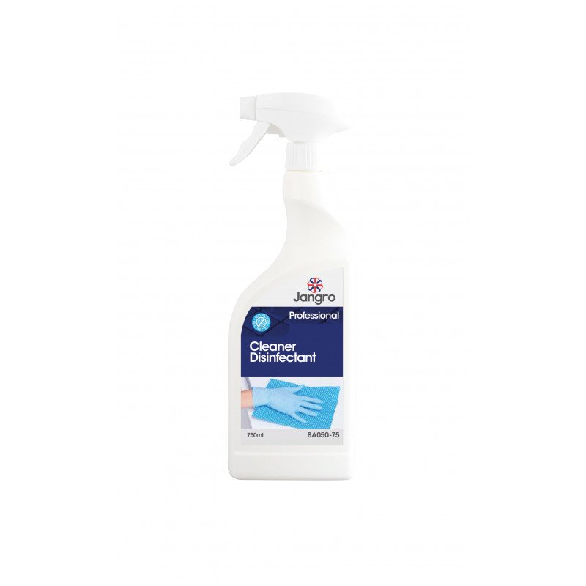
Cleaning
The external cleaning company have been instructed that when passing any door they should clean the door handle. This will mean that they will be sporadic cleaning of door surfaces throughout the work day.
Staff are to clean their workstation before and after commencing their work activities, this is a checkable item on the Daily Check list
Everyone is reminded to wash their hands thoroughly (For a minimum 20 seconds with soap)

Slide 15
Awareness Posters
This poster is displayed throughout the site to make staff aware of the symptoms, preventative measures and what to do in case of possible infection of COVID-19.
Updates are dynamics and may have to change daily in line with government guidelines.
Staff are reminded that while they are on site to listen to their line managers for updates in regards to the changing situation.

Slide 16
Signs
Examples of signs used throughout the site
Sign for water dispenser
Awareness Sign
Sign of required PPE for the site

Slide 17
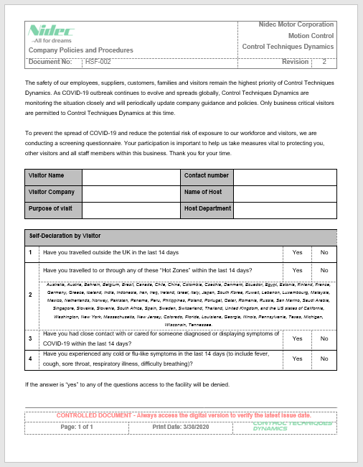
External Visitors
Any authorized visit to site from an external company must complete a visitation document.
All visitors are to have their body temperature taken and asked to disinfect their hands with sanitiser; this is the same with all staff members.
Visitors will be asked to complete a questionnaire before arrival
The visitors must provide their own face masks

Slide 18
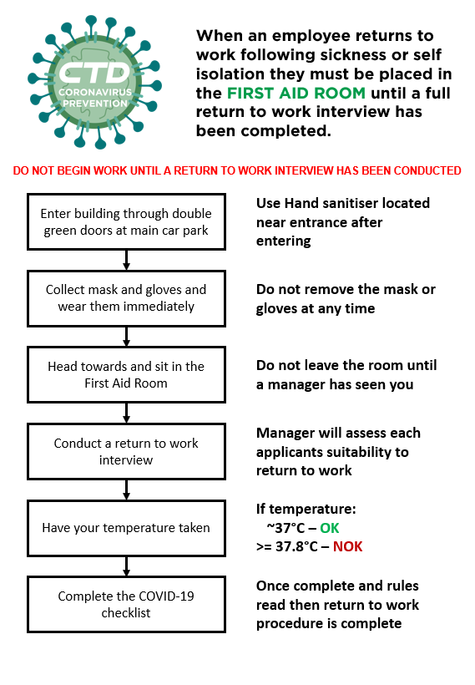
Return to Work
Staff returning to work are instructed to follow a new standard whilst the Coronavirus Prevention Policy is in effect
This process flow outlines the steps to take when a staff member is returning to work from self isolation
The “Return to work” interview is conducted with the same documentation with no additional parameters included
During the interview the manager will ensure that they adhere to the social distancing rules.
Completing the Daily Checklist ensures that the staff member is aware of the rules in place to protect the staff.

Slide 19
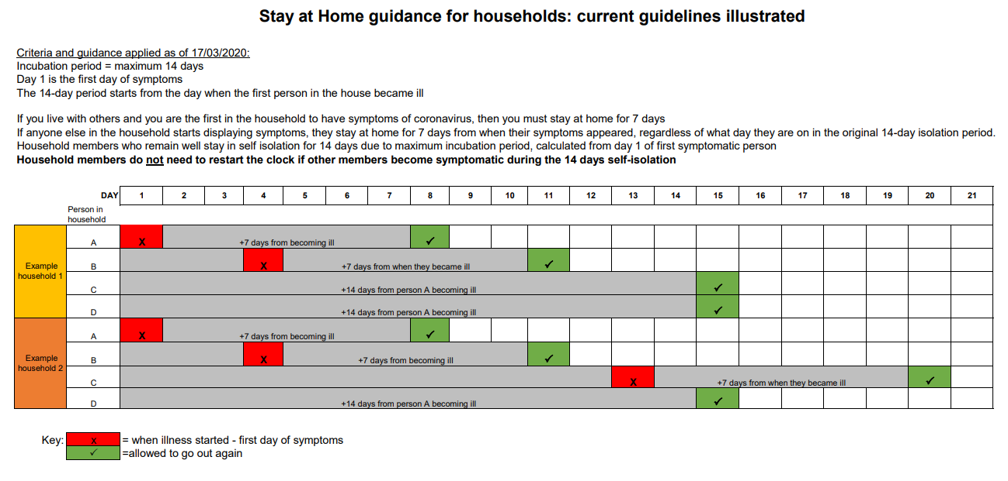
UK Guidelines for self isolation times

Slide 20
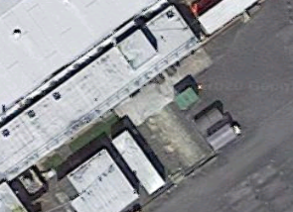
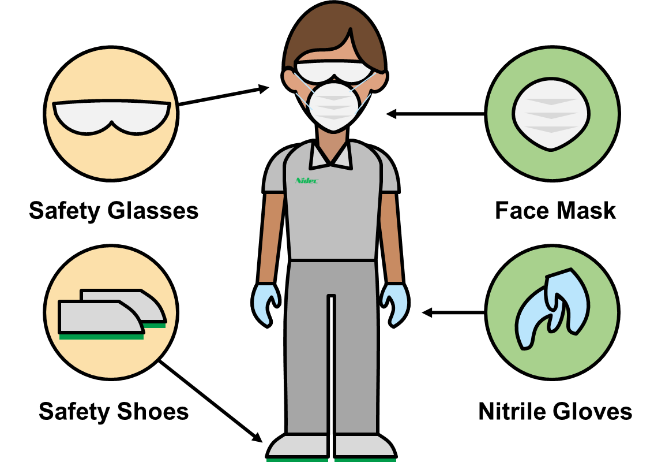
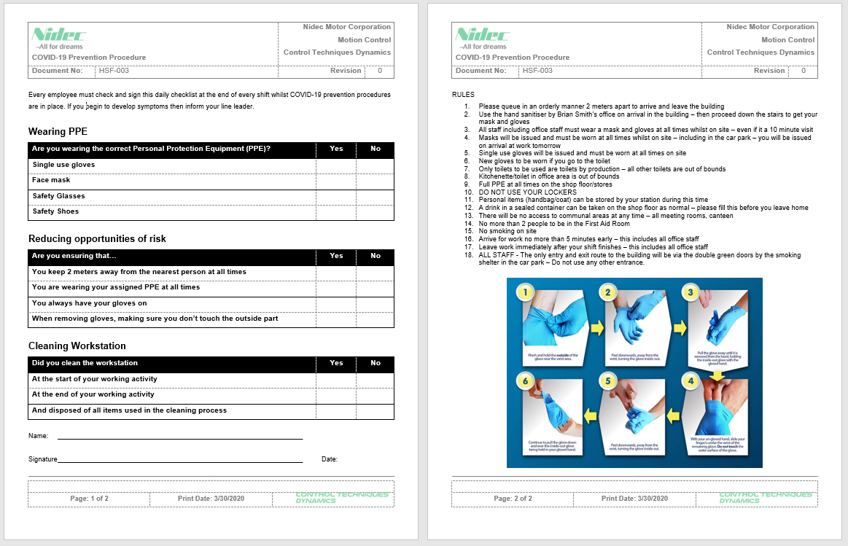
CTD COVID-19 Guidelines
Accessing the building
Always keep your distance
Keep queues minimal
Temperatures checks
LONG QUEUE?
OR
BAD WEATHER?
WHEN ENTERING THE BUILDING, CONDUCTED BY:
OK
RUSSELL STEWART
PAUL
AYLING
2M
NOK
WAIT IN YOUR CAR UNTIL ACCESS BECOMES CLEAR
GEORGE STOCKDALE
Main entrance ONLY
~37℃
≥ 37.8℃
1M
0.5M
Read Awareness Signs
In the building wear PPE
Mask Free Areas
Complete the Daily List
CANTEEN
OUTSIDE
✓
✓
OFFICE
✓
REMEMBER TO ALWAYS
KEEP THE 2 METER DISTANCE!
NO SMOKING ON SITE
NO UNAUTHORISED ACCESS ALLOWED

Slide 21
Displayed information
Information displayed on dashboard monitors
Rotates through 16 slides (1 every 30 seconds) to show current guidelines and information.
Simple and easy information to understand.

Slide 22
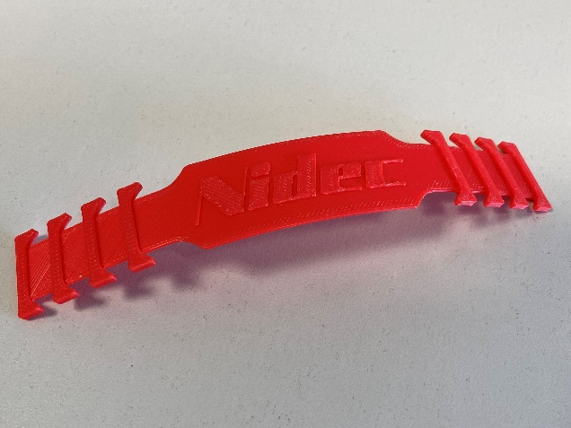
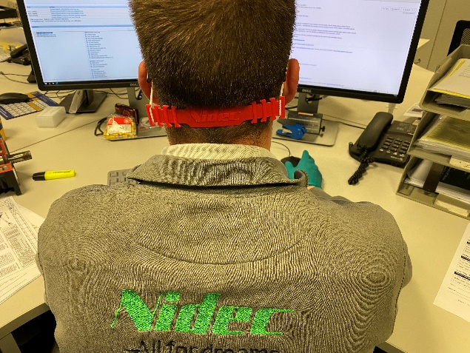
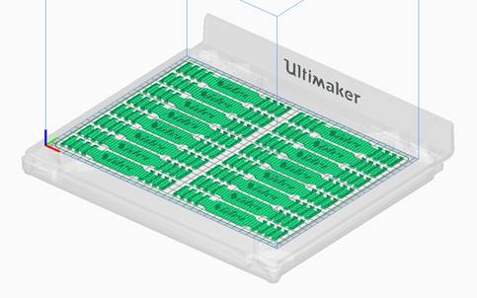
PPE Continuous improvement
Problem – On some mask models, wearing for long period is uncomfortable
Root Cause
Not sitting on face correctly
Pressure applied to ears (on some models)
Thin material on the securing bands
Solution
Expand area for where the securing band can sit so that it doesn’t rest on the ears and can be moved so that the mask can sit more comfortably
3D Printed bracket solution for the masks.
Costs around $0.33 USD each in material

